Slide 1
Survival Analysis of the Titanic Dataset
Key Factors Influencing Passenger Survival
Presenter: Mustafa Syed Siddique
Date: 14-04-2025

Slide 2
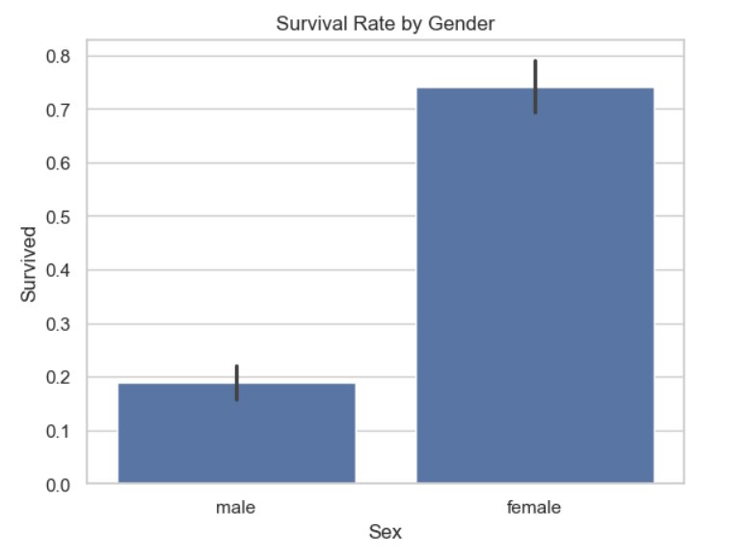
Survival Rate by Gender
Summary of Findings:
The analysis reveals a significant disparity in survival rates based on gender. Females exhibited a substantially higher survival rate compared to males. This suggests that gender played a crucial role in determining survival outcomes within the dataset.

Slide 3
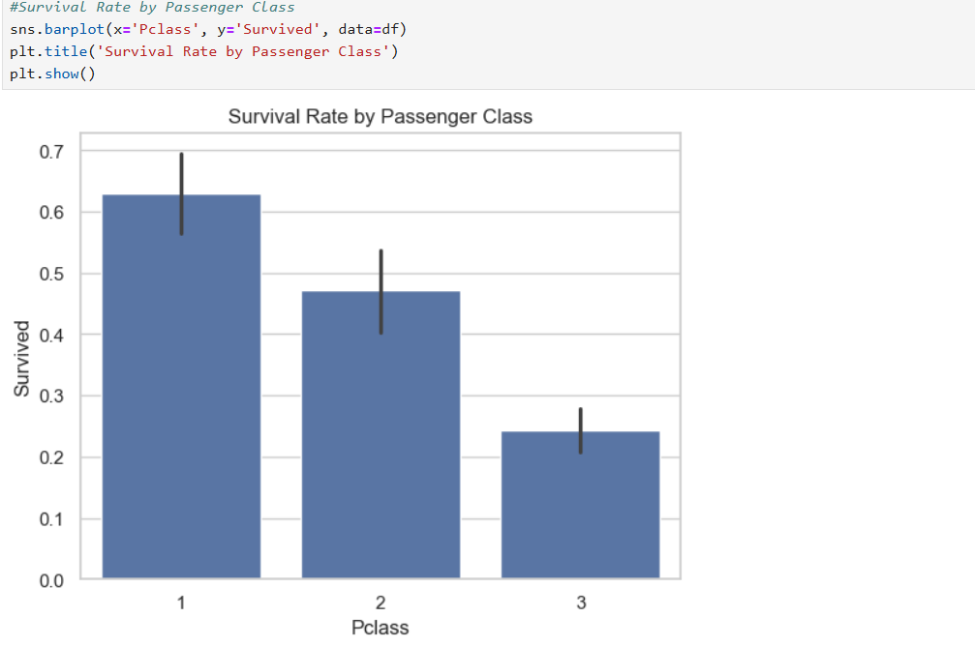
Survival Rate by Passenger Class
Summary of Findings:
The analysis clearly demonstrates a strong inverse relationship between passenger class and survival rate. First-class passengers exhibited the highest survival rate, followed by second-class, with third-class passengers experiencing the lowest survival rate. This suggests a significant impact of socioeconomic status, as reflected by passenger class, on survival outcomes within the dataset.

Slide 4
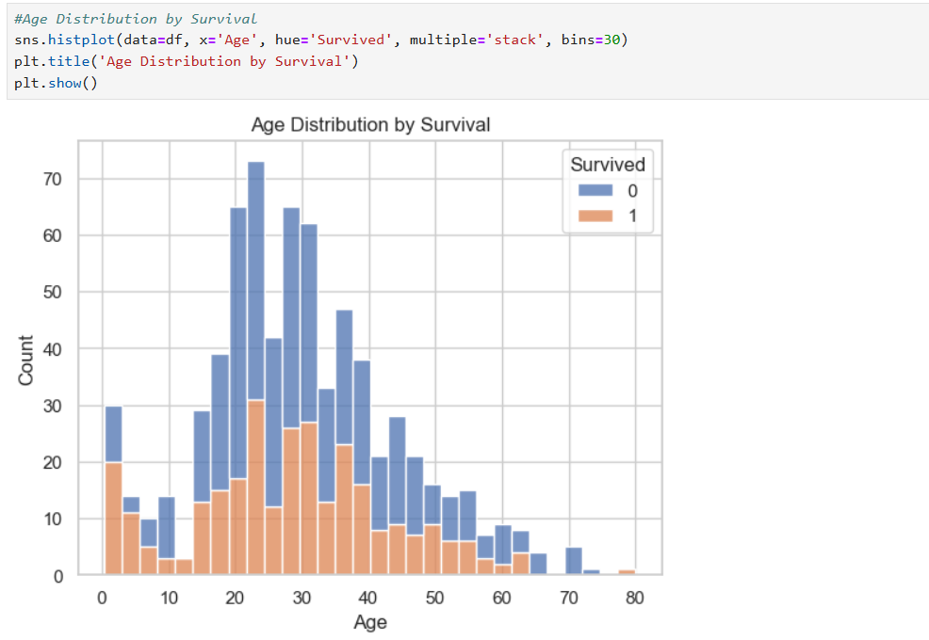
Age Distribution by Survival
Summary of Findings:
The age distribution analysis reveals a clear relationship between age and survival. Younger individuals, particularly children and young adults, exhibited a higher likelihood of survival. Conversely, individuals in their prime adult years (20s-40s) experienced a higher rate of non-survival, and survival rates significantly decreased with increasing age. This suggests that age played a crucial role in survival outcomes, with potential prioritization of younger individuals during the event represented by this dataset.

Slide 5
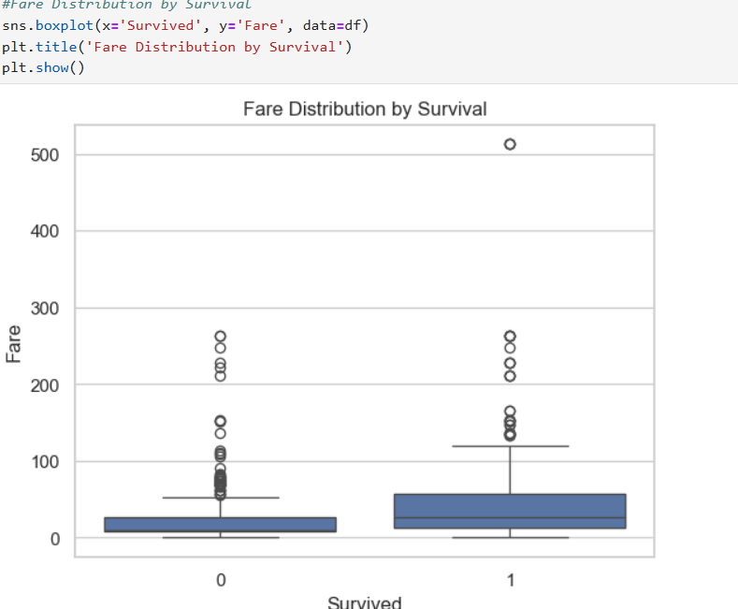
Fare Distribution by Survival
Summary of Findings:
The boxplot analysis indicates a correlation between fare paid and survival. Survivors, on average, paid significantly higher fares compared to those who did not survive. This suggests that passengers who paid more for their tickets had a greater likelihood of survival. Additionally, the fare distribution for survivors shows more variability, with several high-fare outliers, implying that passengers in higher fare categories had a distinct survival advantage.

Slide 6
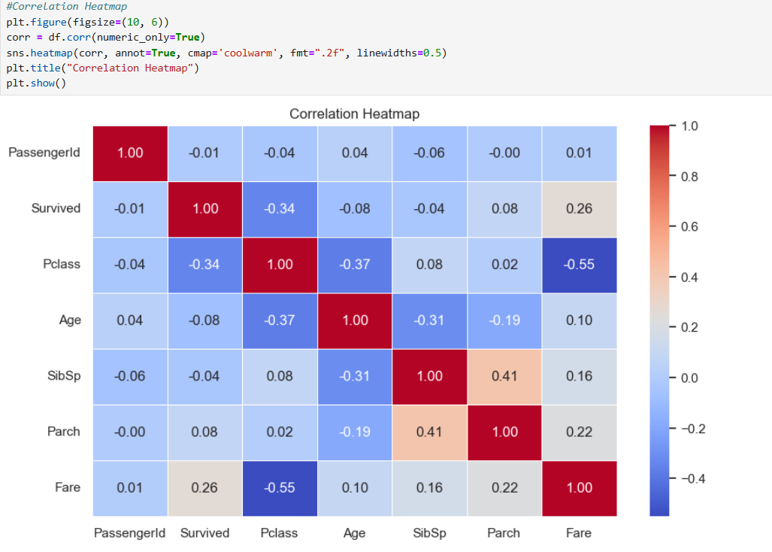
Correlation Analysis
Summary of Findings:
The correlation heatmap reveals notable relationships between features in the dataset. Passenger class (Pclass) shows a moderate negative correlation with survival (Survived), indicating that lower classes had lower survival rates. Fare (Fare) exhibits a moderate positive correlation with survival, suggesting that higher fares were associated with increased survival. There's a strong negative correlation between Pclass and Fare, reflecting that lower classes generally paid lower fares. SibSp and Parch show a moderate positive correlation, suggesting a relationship between family size variables. Age (Age) demonstrates relatively weak correlations with other features. Overall, the analysis highlights the impact of socioeconomic factors (class and fare) on survival outcomes, while age shows less influence.

Slide 7
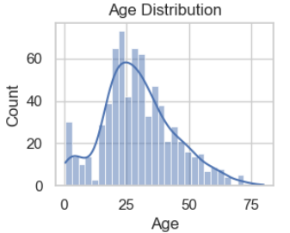
Passenger Age Distribution
Summary of Findings:
The age distribution of the dataset is concentrated around the mid-20s, with a right-skewed pattern. There's a noticeable decrease in frequency towards both very young and older ages. The majority of individuals fall within the 0-50 age range, with a peak around 25 years old, followed by a gradual decline in the number of individuals as age increases.

Slide 8
Conclusion
The Titanic dataset reveals strong patterns in passenger survival.
Gender, class, and fare paid are key predictors of survival:
Females and 1st class passengers had the highest survival rates.
Higher fare generally correlated with increased chances of survival.
Children had better chances than adults or the elderly.
Passengers traveling alone were less likely to survive than those with small families.
These insights highlight the impact of social and economic factors during the disaster.
The analysis forms a strong foundation for building predictive models using machine learning.

